Slide 1
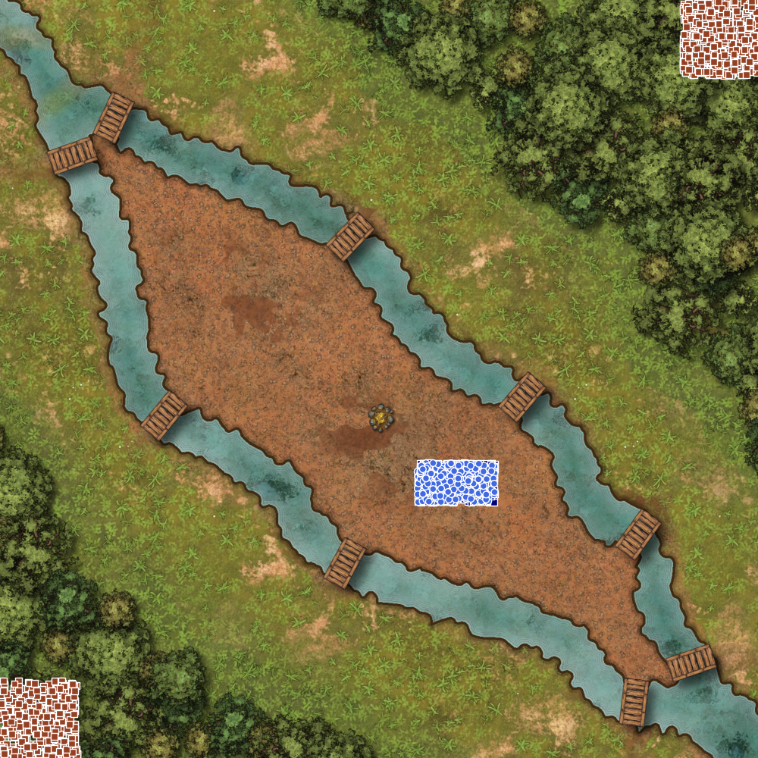
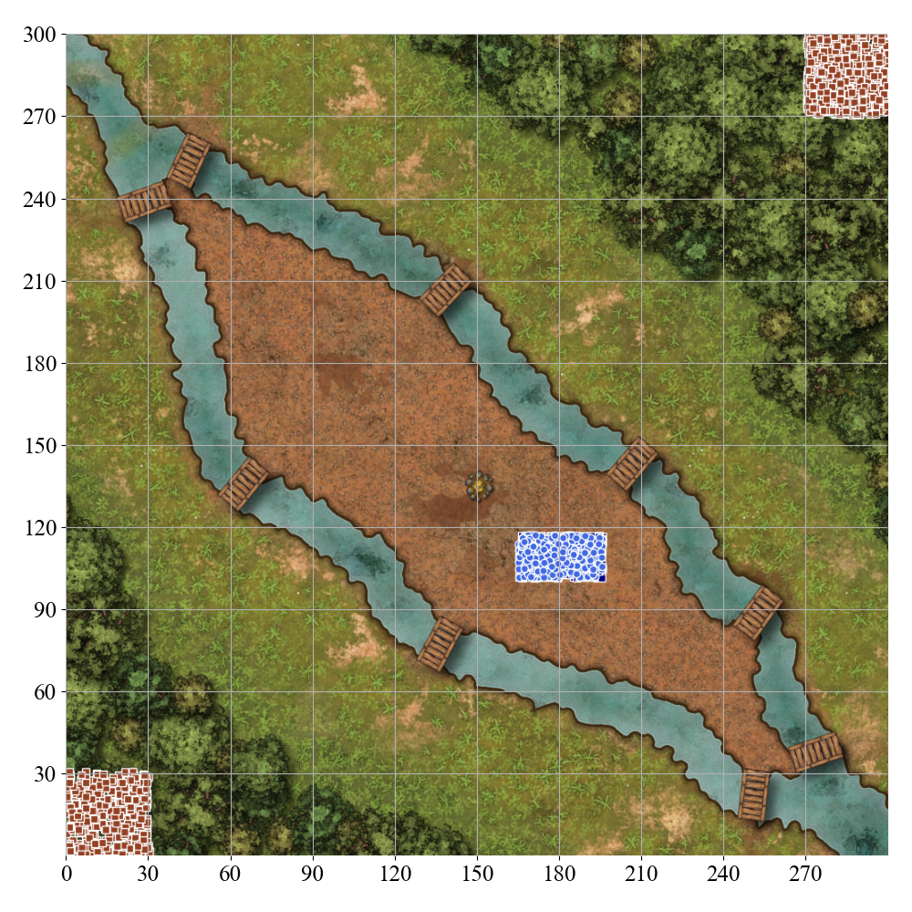
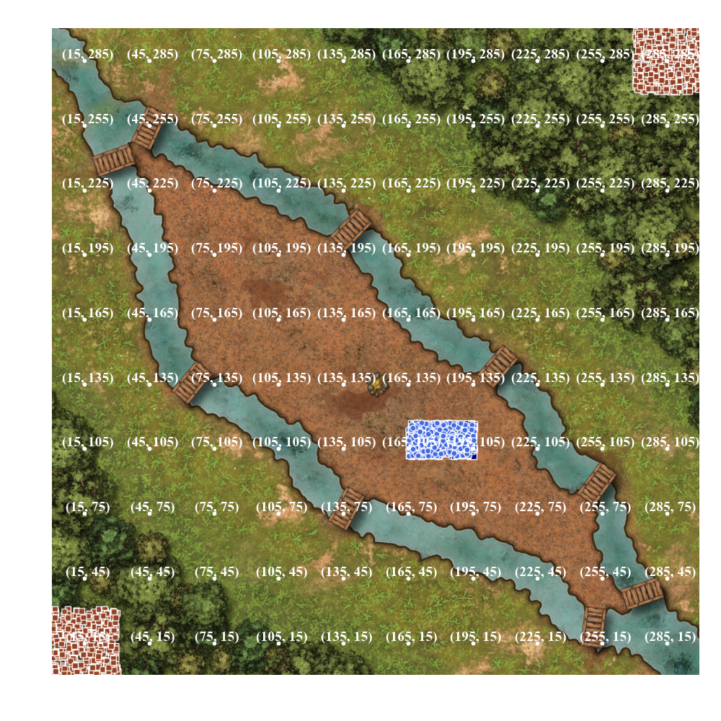
(a) Textual description
Northern River: water [(0, 300), (34, 253), (73, 238), (118, 217), (153, 185), (192, 147), (217, 131), (245, 2), (260, 70), (268, 40), (300, 0)]
Southern River: water [(0, 300), (34, 253), (34, 227), (57, 143), (75, 128), (126, 85), (151, 68), (238, 28), (300, 0)]
Northern Bridge 1: normal at (45, 252)
Northern Bridge 2: normal at (138, 205)
Northern Bridge 3: normal at (205, 142)
Northern Bridge 4: normal at (252, 87)
Northern Bridge 5: normal at (272, 37)
Southern Bridge 1: normal at (29, 238)
Southern Bridge 2: normal at (65, 135)
Southern Bridge 3: normal at (135, 75)
Southern Bridge 4: normal at (249, 21)
Northern Forest: trees at (216, 220) - (300, 300)
Southern Forest: trees at (0, 0) - (57, 48)
(b) Raw image
(c) Grid image
(d) Scaffolding image

